Slide 1
Introduction to Artificial Intelligence

Slide 2

01
What is Artificial Intelligence? Definitions and scope
02
Brief history of AI: From Turing to today
Key Topics in AI
03
Types of AI: Narrow AI vs. General AI
04
Overview of AI technologies
05
Machine Learning, Deep Learning, NLP, Robotics, Computer Vision

Slide 3
Definition and Scope of AI
AI Definition
Artificial Intelligence (AI) is the science and engineering of creating machines that perform tasks requiring human intelligence, such as understanding language, recognizing patterns, and solving problems.
Scope of AI
AI spans a broad range of fields, from simple automation to complex decision-making systems, aiming to enhance human capabilities and revolutionize industries.
Future of AI
The scope of AI is ever-expanding, with potential applications across fields such as healthcare, finance, education, and robotics.

Slide 4

01
Automated learning and reasoning
02
Pattern recognition and data processing
Key Characteristics of AI
03
Adaptability and improvement over time
04
Ability to work with complex data
05
Human-machine interaction

Slide 5

Industry Impact
AI is transforming industries by automating tasks, enhancing decision-making, and enabling predictive capabilities, particularly in healthcare, finance, and retail.
Importance of AI
AI's potential to boost productivity, streamline operations, and create innovative solutions is driving major investments globally.

Slide 6
Considerations for responsible AI
Why is ethical AI development crucial?
Ethics in AI
As AI grows more powerful, ethical concerns around privacy, security, and fairness are essential to ensure AI benefits society and does not perpetuate harm or bias.

Slide 7

Early Milestones in AI
Alan Turing (1950)
Alan Turing, a pioneering computer scientist, proposed the Turing Test to evaluate a machine's ability to exhibit intelligent behavior equivalent to, or indistinguishable from, that of a human.
Dartmouth Conference (1956)
The Dartmouth Conference marked the official birth of AI as a field, gathering prominent researchers to discuss the possibilities of creating intelligent machines.
Early Programs
Programs like Logic Theorist and General Problem Solver demonstrated some of the first attempts at automating reasoning and problem-solving.

Slide 8
Rise of Expert Systems
Definition and Purpose
Expert systems were designed to mimic human decision-making in specific fields by using predefined rules and knowledge bases.
Significance
Expert systems became widely adopted in the 1970s and 80s, especially in medical diagnosis, financial analysis, and manufacturing.
Limitations
Though impactful, expert systems lacked learning capabilities and could not adapt to new data or scenarios outside their programmed knowledge base.

Slide 9
Machine Learning Revolution
Evolution of Machine Learning
Machine Learning (ML) saw a resurgence in the 1990s, with advancements in algorithms that enabled systems to improve based on data rather than fixed programming.
Breakthroughs in Neural Networks
Deep learning, a subset of ML, gained prominence due to neural networks, leading to significant progress in fields such as image and speech recognition.
Current Applications
Machine learning is now essential in applications ranging from recommendation systems to autonomous vehicles, demonstrating broad utility and impact.

Slide 10
Generative AI, GPT models, and more
What are the implications of modern AI advancements?
Recent Breakthroughs in AI
Recent advancements, especially in generative models like GPT, have expanded AI's capabilities in language processing, image generation, and problem-solving, marking a new era in AI.

Slide 11
What is Artificial Intelligence?
Definition
Artificial Intelligence (AI) refers to the simulation of human intelligence in machines, enabling them to perform tasks that typically require human cognition.
Scope
AI encompasses a range of fields, including reasoning, problem-solving, learning, and perception, aiming to create systems capable of mimicking or enhancing human abilities.
Importance
AI has vast implications across industries, from healthcare to finance, impacting automation, decision-making, and predictive capabilities.

Slide 12
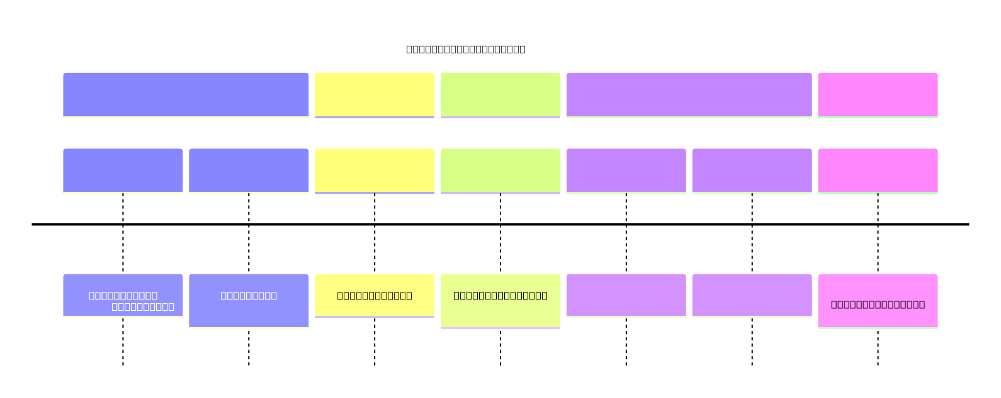
AI History Timeline

Slide 13
Types of Artificial Intelligence
Narrow AI
Narrow AI, or Weak AI, is designed to perform specific tasks without consciousness or general intelligence. Examples include voice assistants and facial recognition systems.
General AI
General AI, or Strong AI, refers to machines that possess the ability to perform any intellectual task that a human can. It remains largely theoretical at this stage.
Future Potential
The progression from narrow to general AI would mark a significant milestone in creating machines with human-like reasoning capabilities.

Slide 14



Core AI Technologies
Overview of essential AI technologies such as Machine Learning, Deep Learning, NLP, Robotics, and Computer Vision.

